Slide 1
#BrandName#
#Date#
Monthly Summary Report

Slide 2
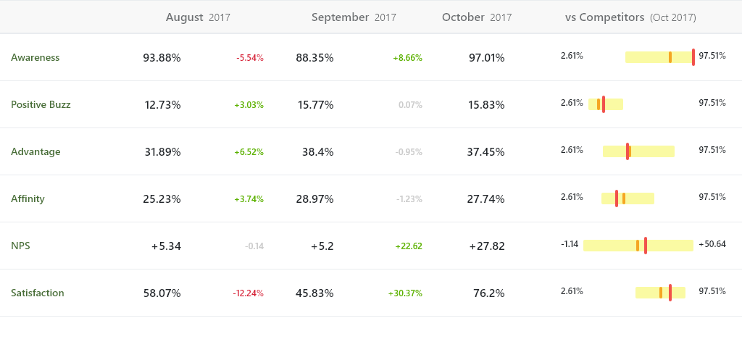
Summary Scorecard - #BrandName#
Performance across key indicators of brand performance

Slide 3
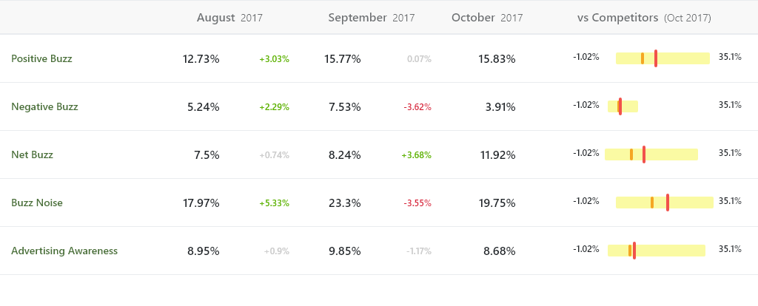
Brand Attention Scorecard - #BrandName#
Performance across the factors that capture the level of excitement and attention around your brand.

Slide 4
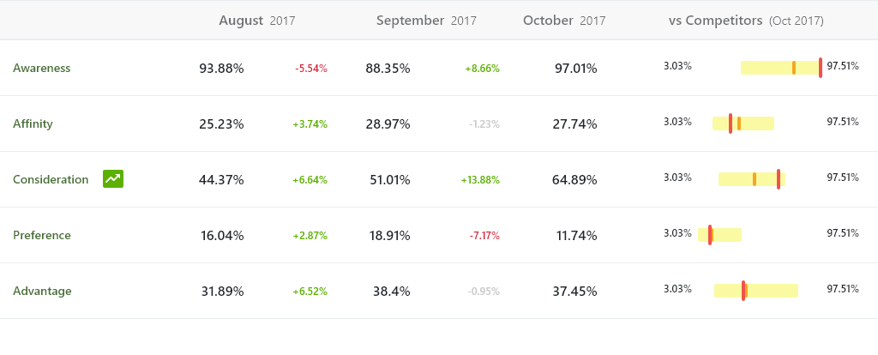
Brand Health Scorecard - #BrandName#
Performance across the factors that capture the knowledge and preference for each brand that can lead to a visit and purchase.

Slide 5
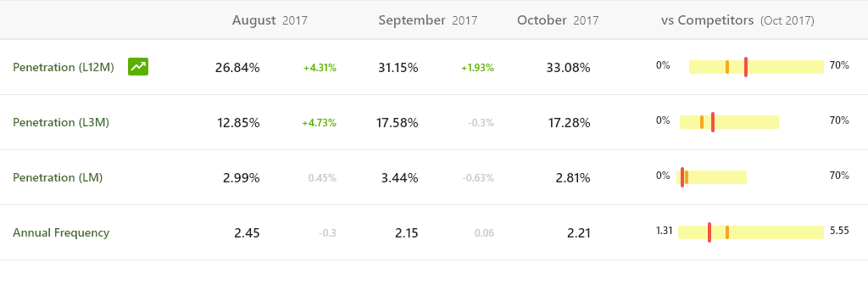
Demand & Usage Scorecard - #BrandName#
Performance across the factors that capture the demand for each brand that and visit frequency.

Slide 6
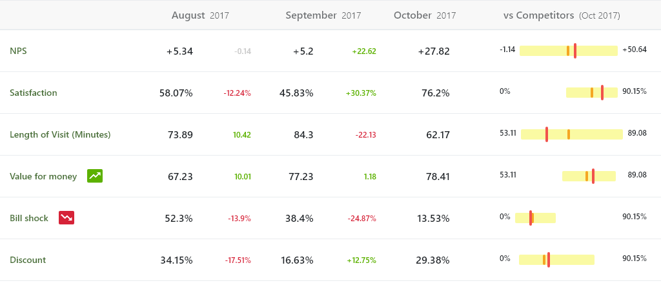
Customer Experience Scorecard - #BrandName#
The level of customer satisfaction and advocacy for the brands.

Slide 7
Morar HPI
Woolyard
54 Bermondsey Street
London SE1 3 UD

